Slide 1

Super resolution using CNN
Richard Hemphill
ECE5268
Dr. Anagnostopoulos
Individual Class Project Topic

Slide 2
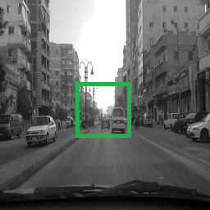
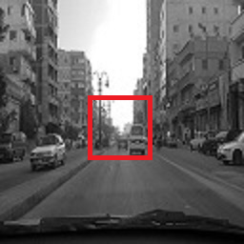
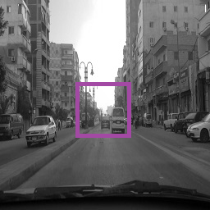
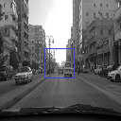



Description
Using small-sized grayscale images, construct a CNN-based architecture that will magnify and enhance the images by a factor of 2.
Original Image
Reduced Image
Magnified Image
Super Resolution

Slide 3
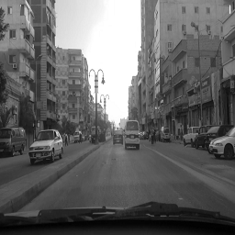
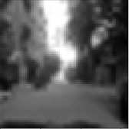
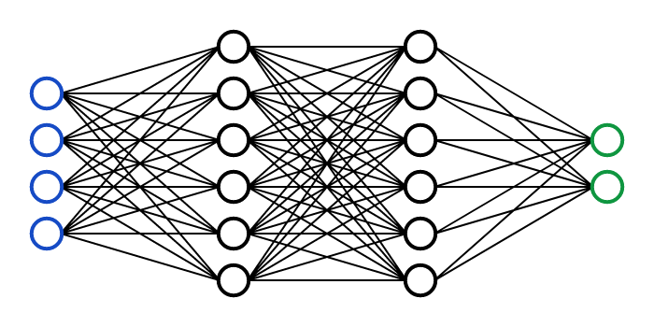
Goal
The goal of the project is to construct Python code to import and extract a dataset, take shrunken images with the original, pre-process (i.e., magnify), and train a CNN (Convolutional Neural Network) to enhance the image close to the original.
Image Dataset
error
reduce
magnify
Neural Network

Slide 4
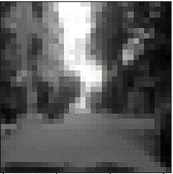
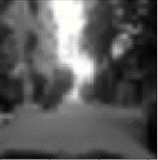
Architecture
The model creates feature maps of the interpolated image, decreases the dimensionality, then reconstructs the expected high-resolution image.
Feature Maps of Low-Resolution Image
Feature Maps of High-Resolution Image
Low Resolution Image
Magnified Image
Super Resolution Image
Bicubic Interpolation
Patch Extraction and Representation
Non-Linear Mapping
Reconstruction

Slide 5
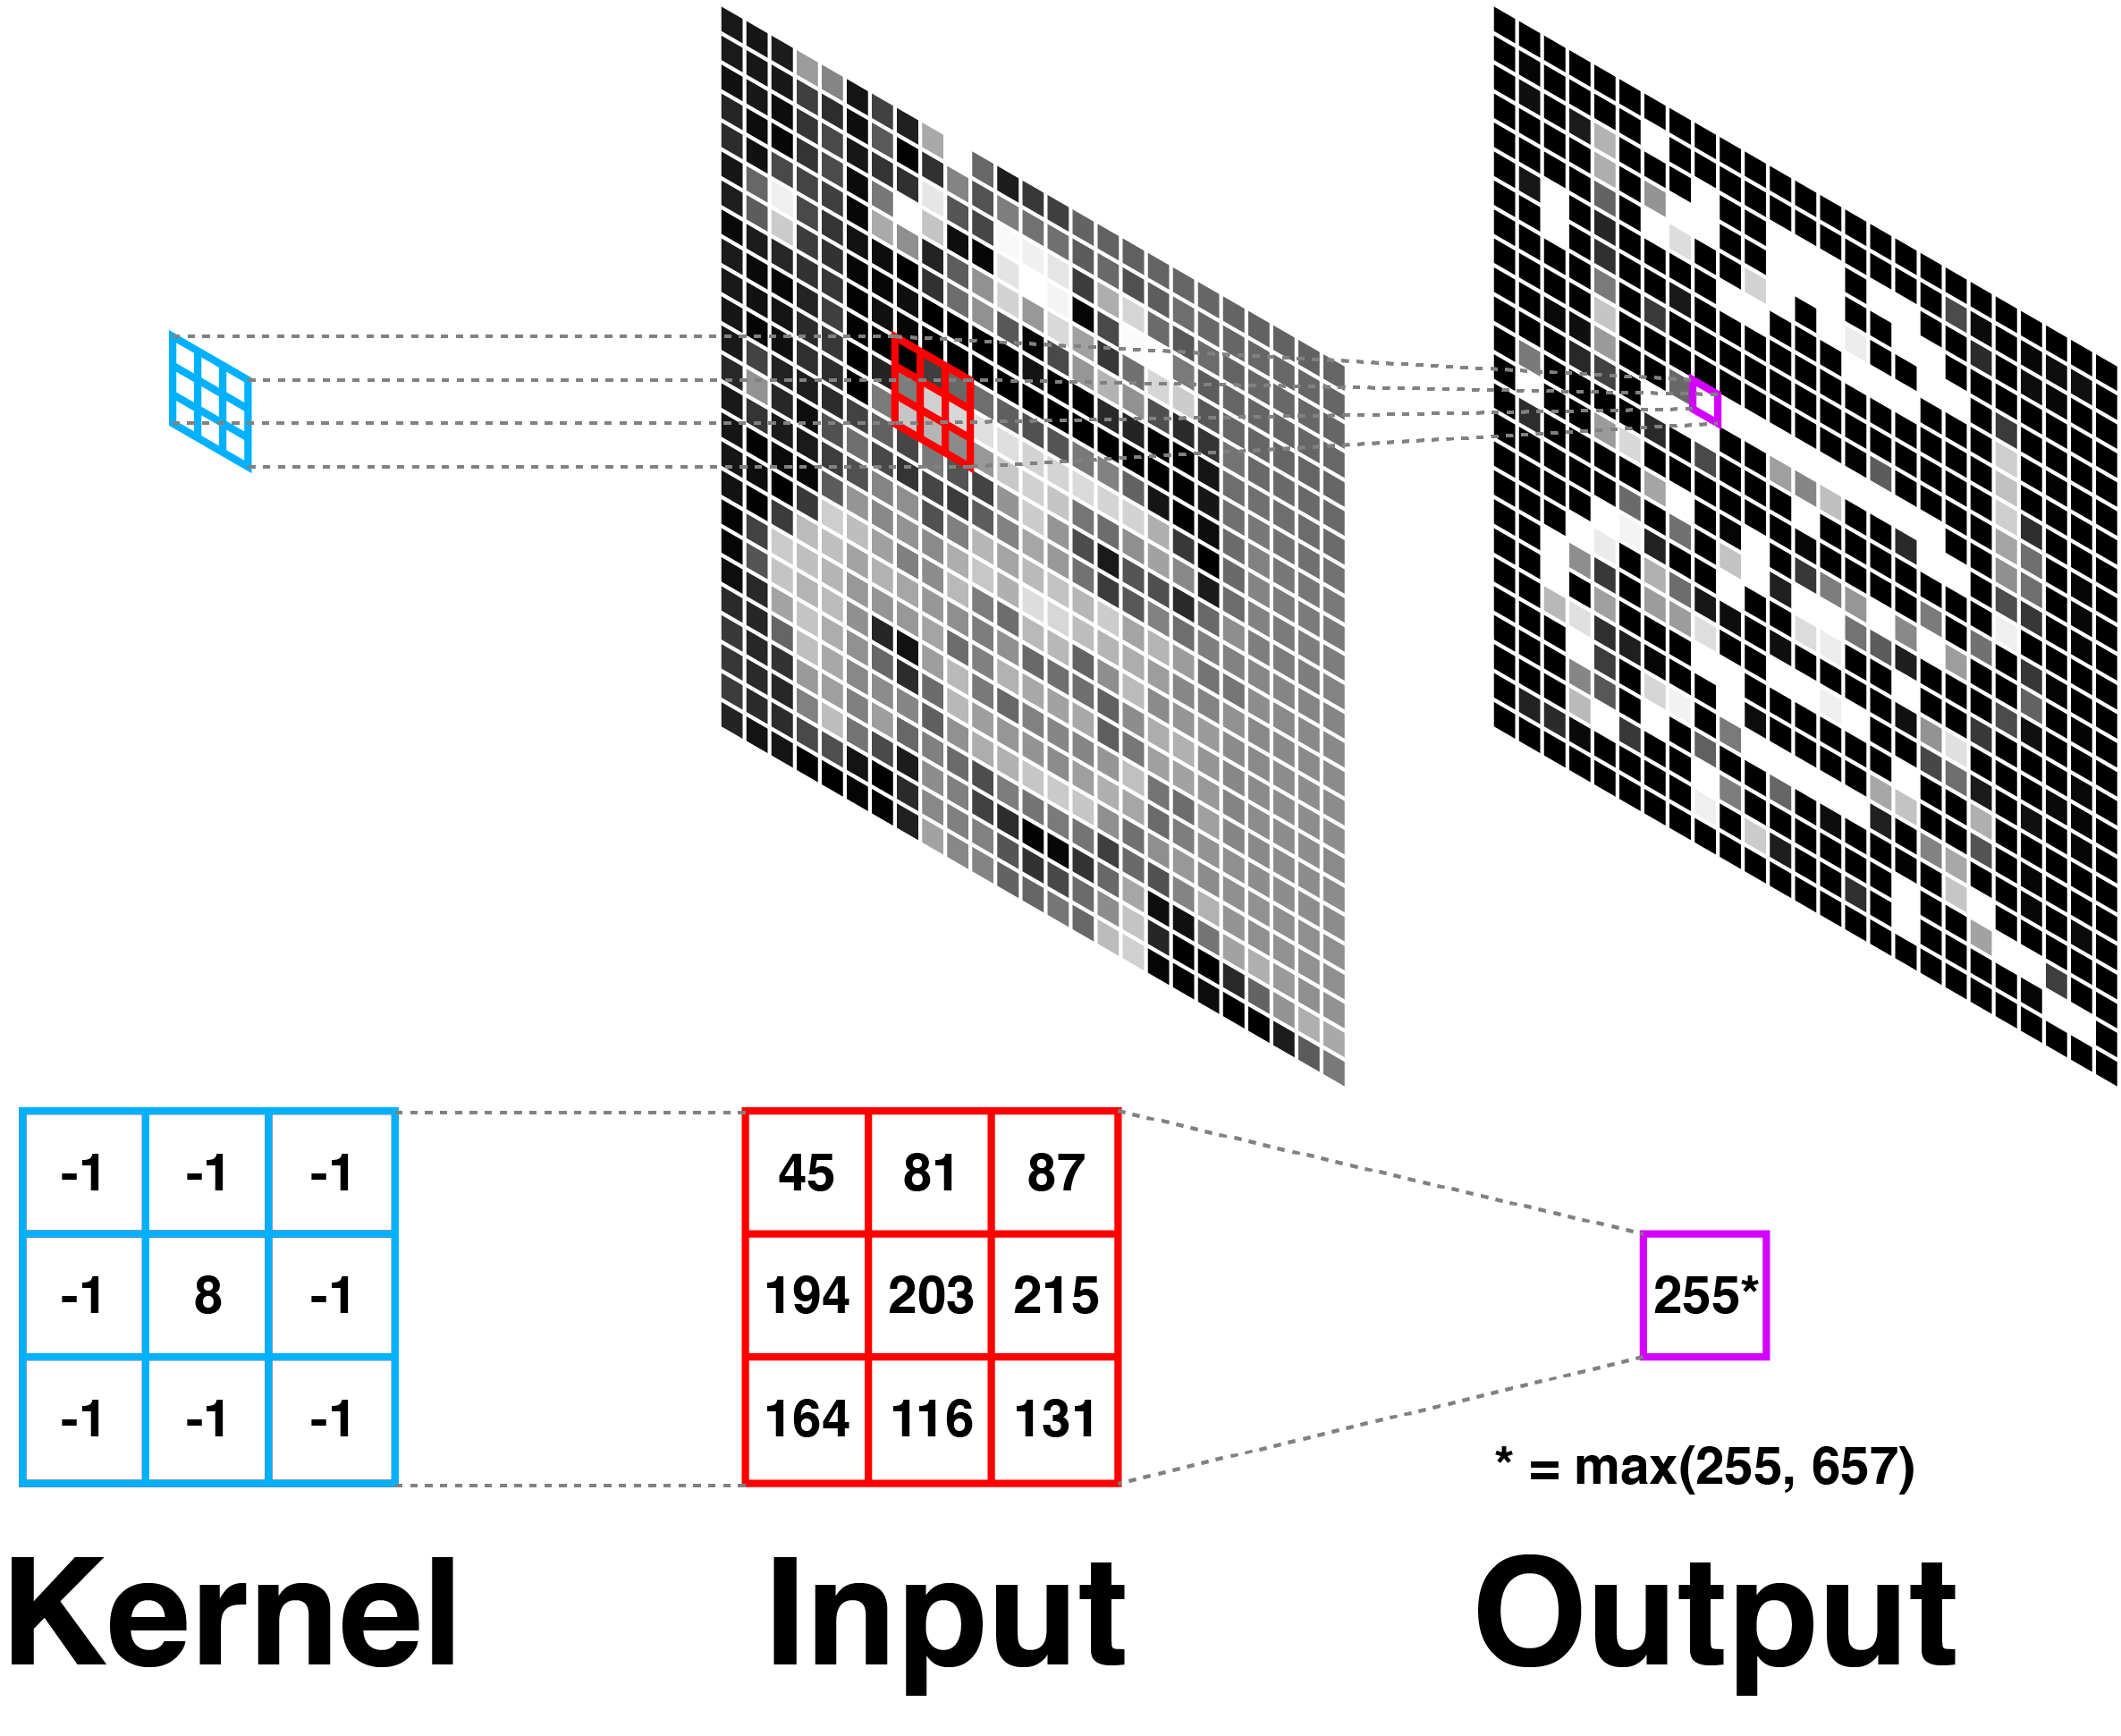
Convolutional Layer
The model includes 3 convolutional layers. During training, the weight (i.e., kernel values) and biases are incrementally updated to toward results that produce results closer to the original image. To optimize speed, no pooling or fully connected layers are utilized.

Slide 6
Parameters (Design Decisions)
Following are the design decisions if larger values were used:
Number of Kernels
marginally increase quality
drastically affect speed of training
Kernel Size
marginally richer structural information
drastically affect speed of training
Number of Layers
no apparent improvement in image quality
increases convergence time.

Slide 7
Parameters (Deviations)
Following are technical paper used and the deviations.
Learning Rate
Per tech paper, 10⁻⁴ for first 2 layer and 10⁻⁵ for last.
unknown how to apply rate on layer instead of model w/ Keras, thus 10⁻⁴ was applied across
Strides
Per tech paper, 14 for small set of 91 training images and 33 for large set of 5 million images.
Error occurred when value was set in ICP. Thus, the default of 1 was used.
Kernel Initializer
Tech paper used Gaussian distribution with zero mean and 0.001 standard deviation.
RandomNormal(mean=0.0, stddev=0.001) was attempted, but resulted in black image (even after 10,000 epoch).
The Orthogonal() was used by Xingyu Long and worked for this project.

Slide 8
Model layers
5 columns
9 columns
1 column
9 rows
5 rows
1 row
4 kernels
64 kernels
32 kernels
64 images
32x32
32 images
64x64
*
Feature maps of most important aspects needed to produce a better-quality image.
*
Feature maps with edge and details enhanced.
*
Patch Extraction and Representation
Non-Linear Mapping
Reconstruction

Slide 9
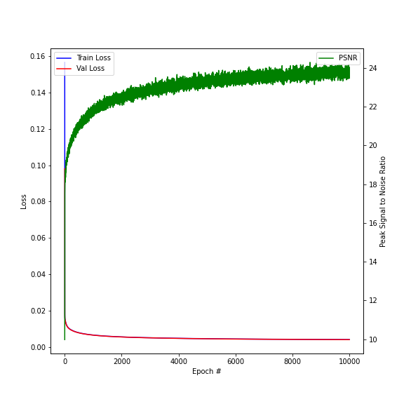

Training
As the model is trained, the image quality improves.
PSNR$=10\log_{10}\left(\frac{1}{Train Loss}\right)$

Slide 10
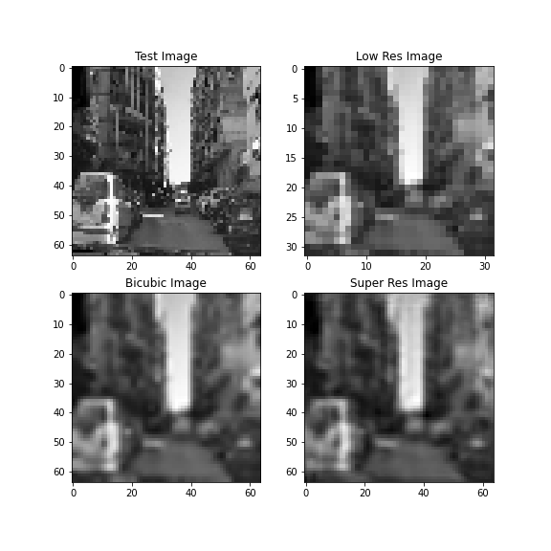
Test
Performing magnification via super resolution produced a slightly lower image quality than bicubic interpolation.
PSNR
Bicubic: 25.1
Super Resolution: 20.3
Note: Image PSNR is lower than model training PSNR.

Slide 11
References
C. Dong, C. C. Loy, K. He and X. Tang, "Image Super-Resolution Using Deep Convolutional Networks," in IEEE Transactions on Pattern Analysis and Machine Intelligence, vol. 38, no. 2, pp. 295-307, 1 Feb. 2016, doi: 10.1109/TPAMI.2015.2439281.
Goose, Mr. “AlexOnly_Greyscale,” January 22, 2020. https://www.kaggle.com/spaceengineer1/alexonly-greyscale.
Long, Xingyu. “Image Super-Resolution Using an Efficient Sub-Pixel CNN,” 2020. https://keras.io/examples/vision/super_resolution_sub_pixel/.
Hemphill, Richard. “Richardhemphill/SuperResolution.” GitHub. Accessed April 11, 2021. https://github.com/richardhemphill/SuperResolution.
Daniel, Jeff. Medium. Accessed April 11, 2021. https://medium.com/@jeff.daniel77/accessing-the-kaggle-com-api-with-jupyter-notebook-on-windows-d6f330bc6953.

